Slide 1
CSE7000 - INTERNSHIP A Presentation on Smart Classroom Behavior Detection using YOLOv8
Student Details
Name | B S Vanisha Babu
Roll No | 20241CSG0007
Section
Under the Supervision of,
Rajesh Wagle , Manager BEL
Dr./Mr./Ms./Prof.
Professor / Associate Professor / Assistant Professor
Presidency School of Computer Science and Engineering
Presidency University
Name of the Program: Computer Science and Technology (AIML)
Name of the HoD: Dr. Pallavi R
Name of the Program Internship Coordinator: Mr. Saptarsi Sanyal
Name of the School Internship Coordinators: Dr. Bhuvaneshwari Patil

Slide 2
Content
About Company or Organization
Working domain or the Technology
Objectives of the work
Methodology Used
Results
Conclusion

Slide 3
About Company or Organization
Bharat Electronics Limited (BEL) is a leading Navratna Public Sector Undertaking (PSU) under the Ministry of Defence, Government of India. Established in 1954, BEL plays a significant role in strengthening India's defence capabilities by designing, developing, and manufacturing advanced electronic systems.
The company has nine manufacturing units across India and several regional offices, providing high-quality electronic products and solutions for defence, aerospace, homeland security, and civilian sectors. BEL is also actively involved in research and development, focusing on emerging technologies such as Artificial Intelligence, Cyber Security, and Communication Systems.

Slide 4

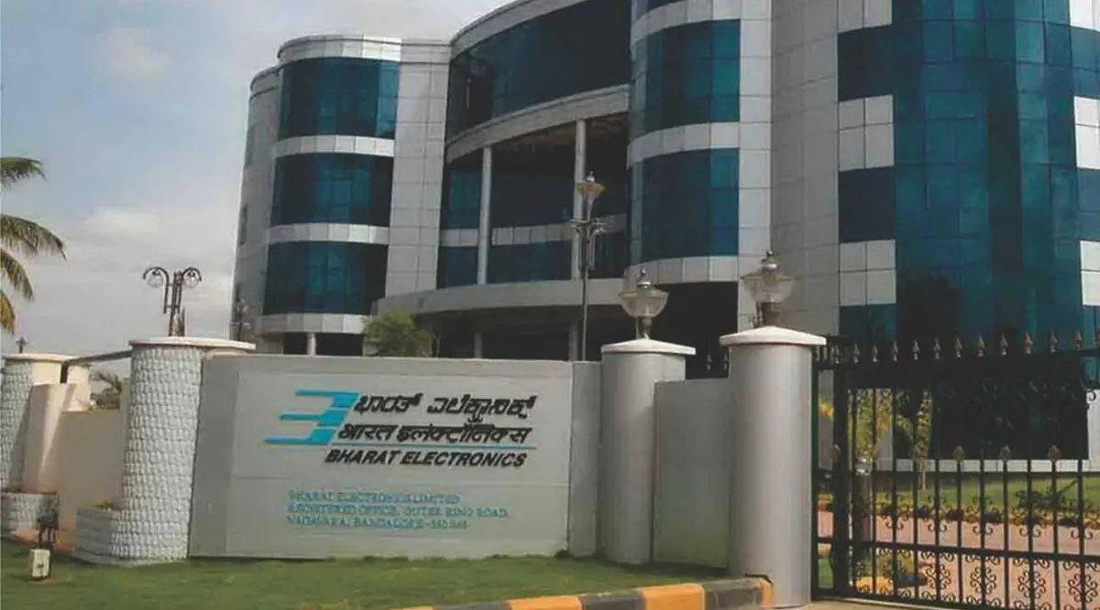
About Company or Organization
BEL LOGO
BEL CAMPUS

Slide 5
Working domain or the technology
Computer Vision using YOLOv8
What is Computer Vision?
Computer Vision is a branch of Artificial Intelligence that enables computers to understand, analyze, and interpret images and videos automatically.
Key Features
Real-time object detection and recognition.
Accurate identification of multiple objects simultaneously.
Deep learning-based image analysis.
Supports image and video processing.
High speed and efficient performance using YOLOv8.
Importance
Reduces manual monitoring.
Improves automation and accuracy.
Enables smart surveillance and classroom monitoring.
Widely used in healthcare, autonomous vehicles, security, and education

Slide 6
Objectives of the work
Develop a Smart Classroom Behavior Detection system using the YOLOv8 object detection model.
Detect and classify eight different student classroom behaviours from images and videos.
Train and evaluate the model using a labeled classroom behaviour dataset.
Analyze the model's performance using standard evaluation metrics.
Gain practical experience in Computer Vision, Deep Learning, and AI-based application development.

Slide 7
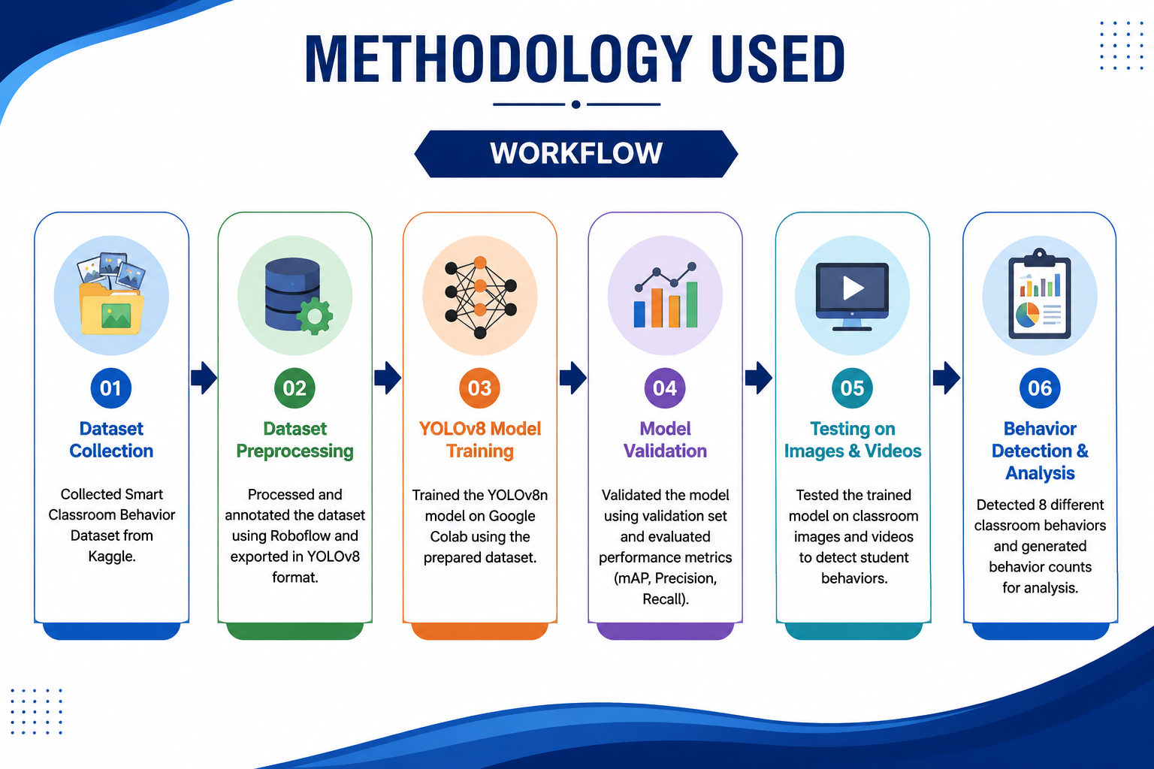
Methodology Used
Collected the Smart Classroom Behavior Dataset from Kaggle.
Preprocessed and organized the dataset using Roboflow.
Trained the YOLOv8n model using Google Colab.
Evaluated the model using Precision, Recall, and mAP metrics.
Tested the trained model on classroom images and videos.
Detected student behaviours and generated behaviour counts for analysis.

Slide 8
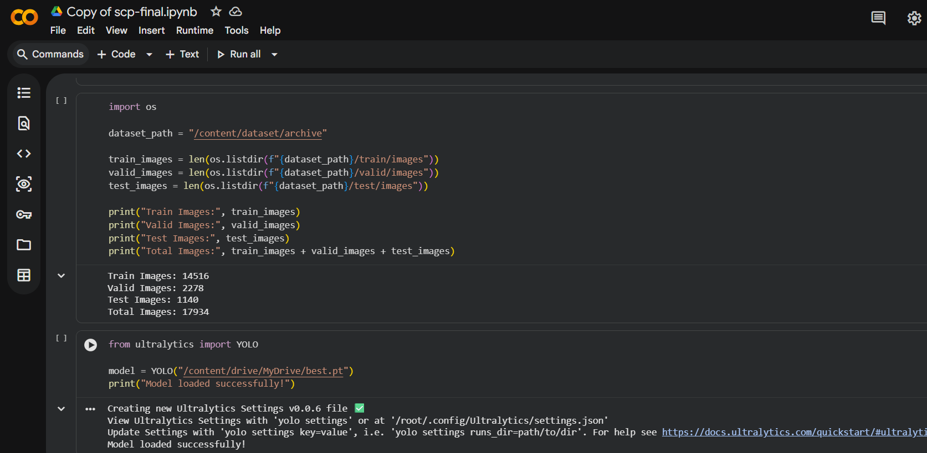
Implementation
Imported the required Python libraries, including Ultralytics YOLOv8, OpenCV, and Matplotlib.
Loaded the prepared dataset into Google Colab for model training
Trained the YOLOv8n model for 50 epochs using the classroom behaviour dataset.
Monitored training performance through loss graphs and evaluation metrics.
Saved the best-performing model (best.pt) for testing and prediction.

Slide 9
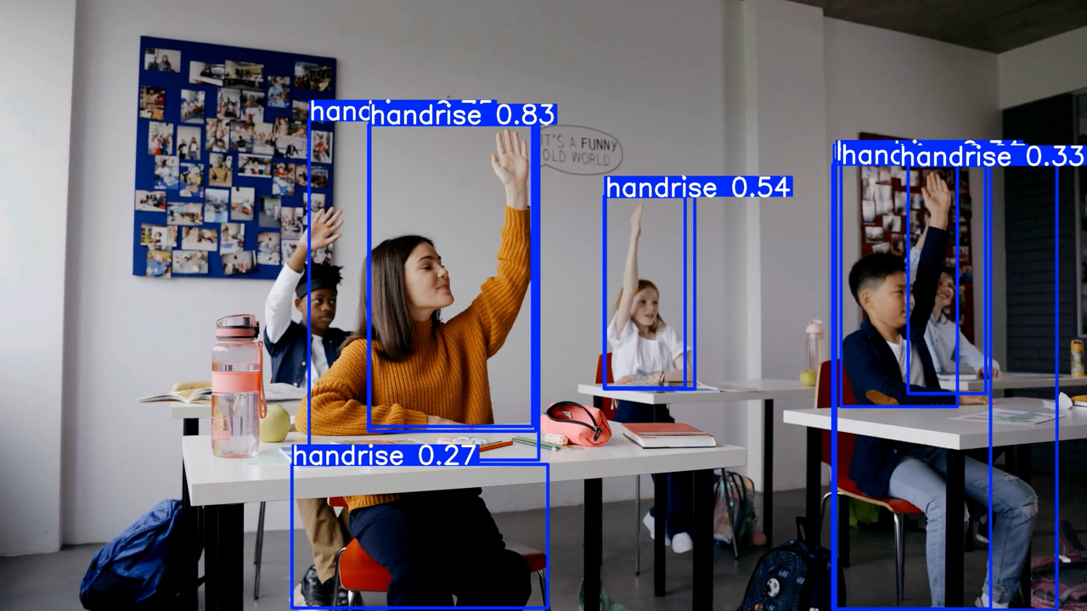
Results
Successfully trained the YOLOv8n model for classroom behavior detection.
Accurately detected 8 different student behaviors from classroom images and videos.
Generated bounding boxes, behavior labels, and confidence scores for each detected object.
Implemented behavior counting for classroom activity analysis.
Demonstrated the effectiveness of Computer Vision for smart classroom monitoring.
Achieved the project objectives by developing a reliable AI-based behavior detection system.

Slide 10
Conclusion
Successfully trained the YOLOv8n model for classroom behavior detection
Accurately detected 8 different student behaviors from classroom images and videos
Generated bounding boxes, behavior labels, and confidence scores for each detected object.
Implemented behavior counting for classroom activity analysis.
Demonstrated the effectiveness of Computer Vision for smart classroom monitoring.

Slide 11
Q&A

Slide 12
Thank you !!

